Slide 1

Name | Batch
Himanshi Singhal | PGDM-RBA
Arik Biswas | PGDM-RBA
Prashant Pujari | PGDM-RBA
Tanmoy Biswas | PGDM-EBIZ
Sarvesh Ghadge | PGDM-Core
Anjali More | PGDM-RBA

Slide 2
Analysing the Zomato Restaurants in Bangalore
Visualizing the online order facility.
Analyzing the online order vs no online order facility in terms of rating.
Analyzing the table booking facility vs no table booking facility in terms of rating.
Analyzing the online order facility (location-wise)
Analyzing number of votes (location-wise)

Slide 3
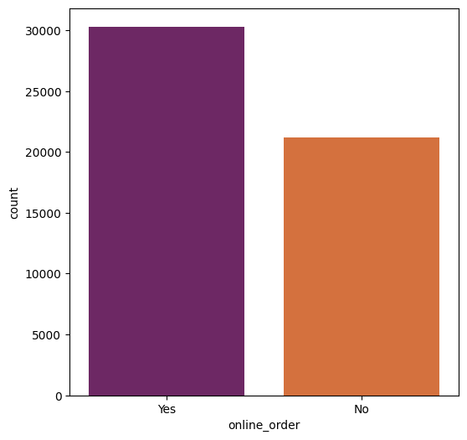
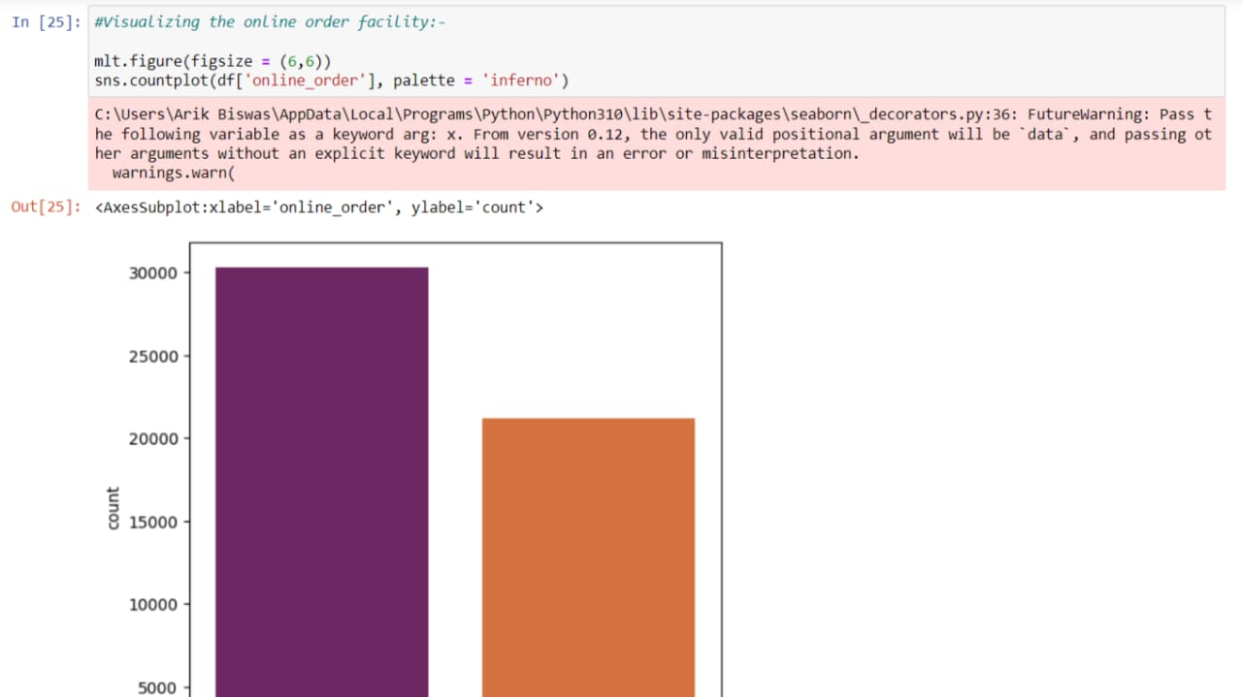
Here, we visualize the online order facility.

Slide 4
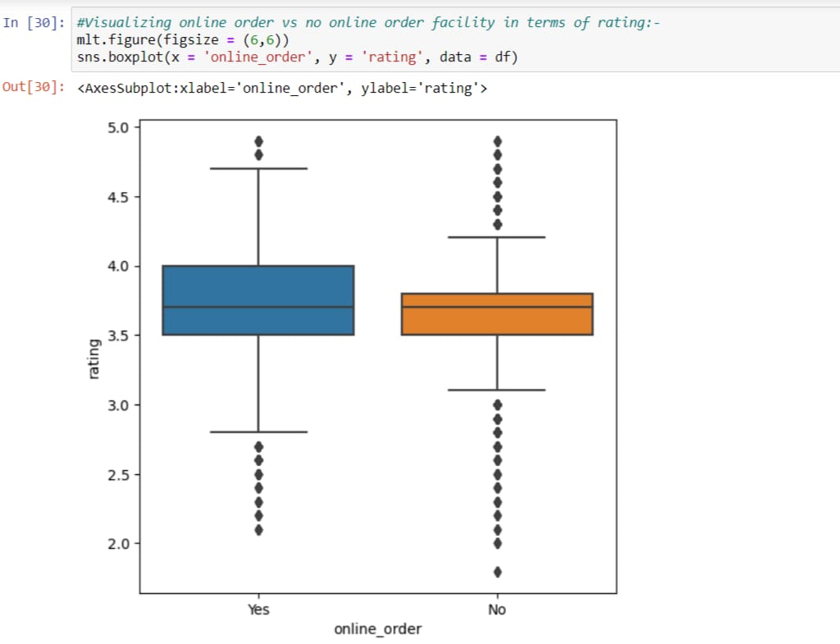
Here we visualize the online order vs no online order facility in terms of ratings

Slide 5
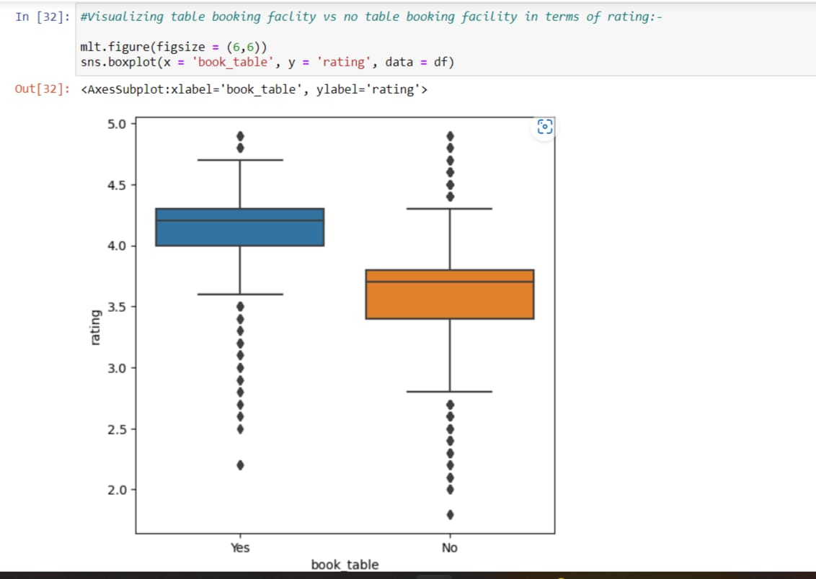
Here we visualize the table booking facility vs no table booking facility in terms of rating

Slide 6
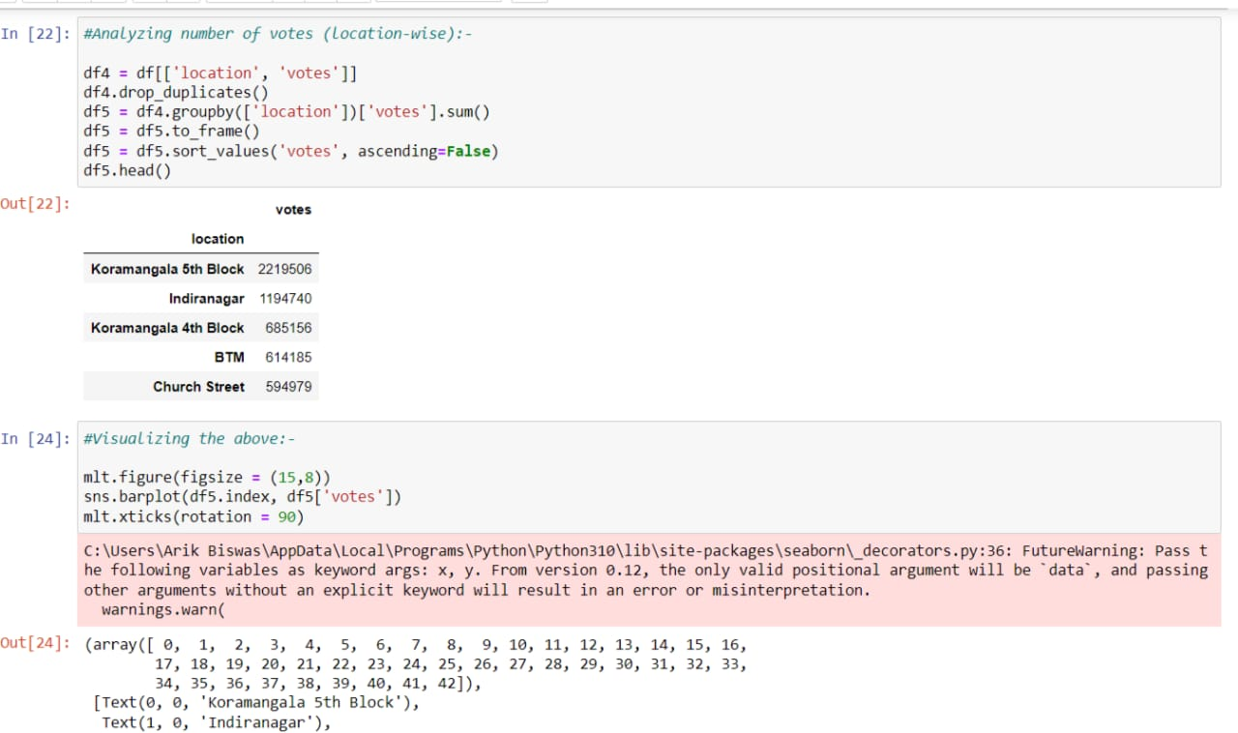
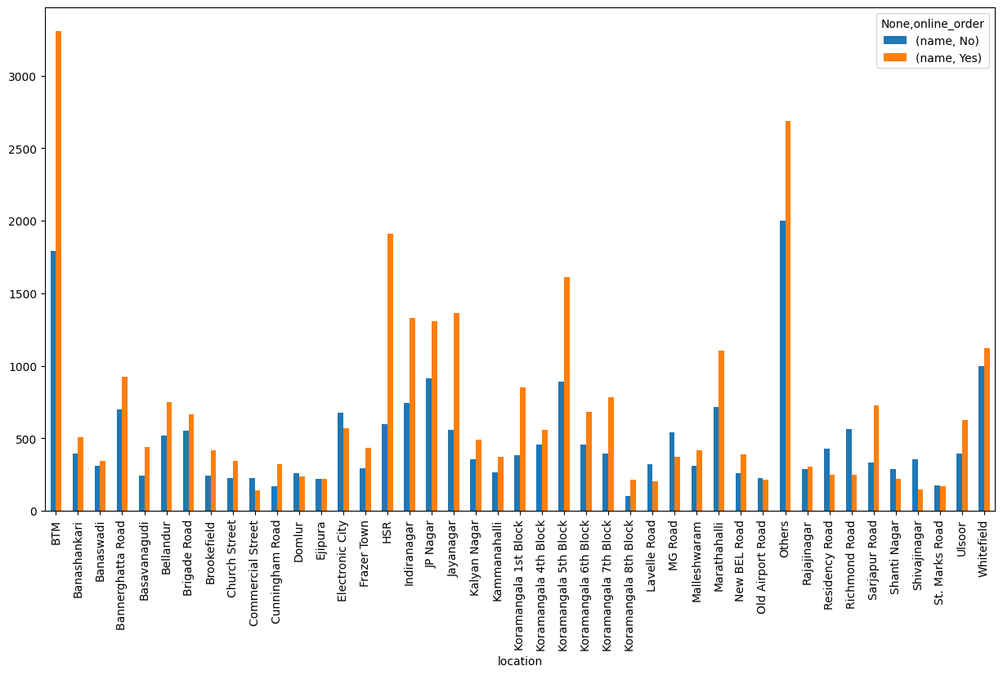
Here we visualize the number of votes (location-wise)

Slide 7
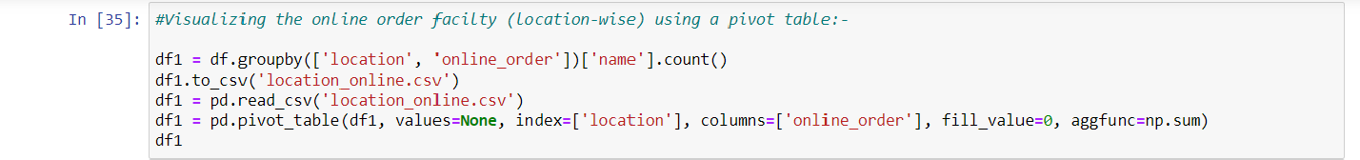
Here we visualize the online order facilty (location-wise):-

Slide 8
THANK YOU
We are thankful to REDX Lab especially to Aditya Chavan Sir who helped us in cleaning the data even before beginning the research.

